Slide 1

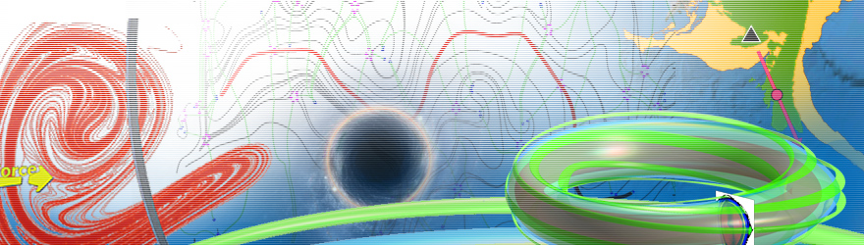
生物动力系统模拟
吴韵怡（助教）
王冠宇 18665955633
wanggy@sustc.edu.cn

Slide 2
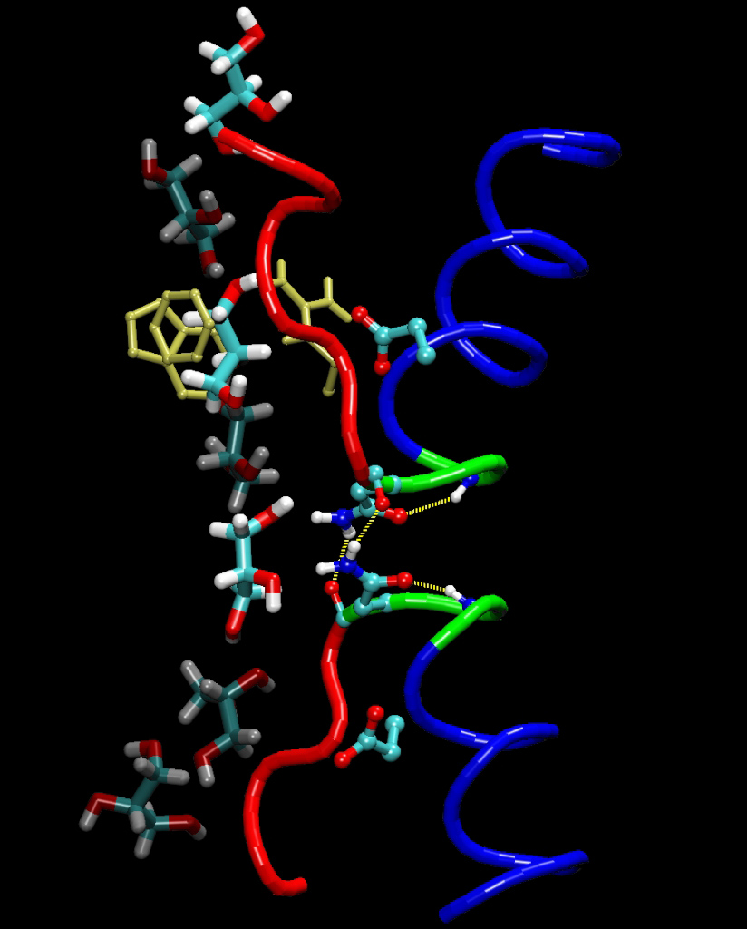
Molecular Dynamics Simulation
Notes:
<number>

Slide 3
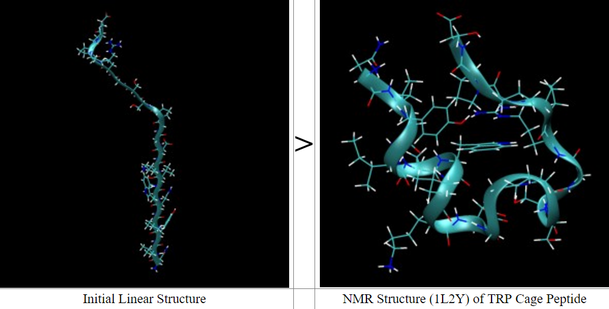
Example 2: All Atom Structure Prediction and Folding Simulations of a Stable Protein by the software Amber
The small size (20 aa) of this protein makes it an ideal candidate for computational folding simulations.
When the original folding simulations were done the experimental structure had not been solved.
When the experimental structure was solved the predicted structure was within 1.4 angstroms RMSD.

Slide 4
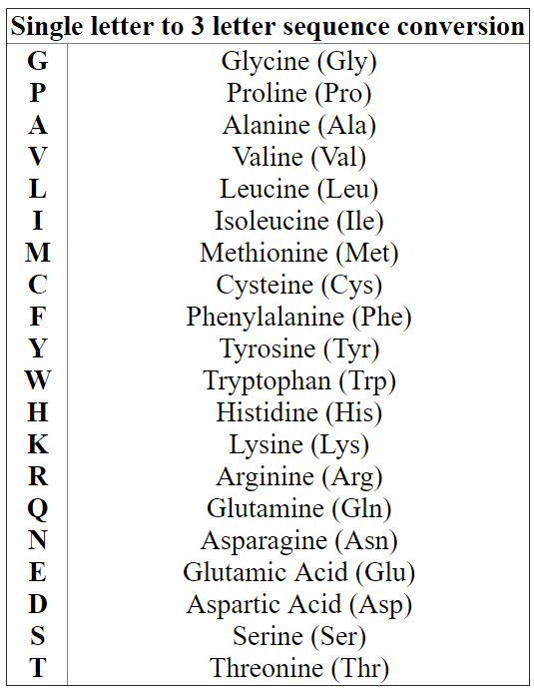
1: Building the starting structure
The amino acid sequence is: NLYIQWLKDGGPSSGRPPPS
So the sequence can be re-written as:
ASN LEU TYR ILE GLN TRP LEU LYS ASP GLY GLY PRO SER SER GLY ARG PRO PRO PRO SER
We have to specify our N terminus, by prefixing it with an N, and our C terminus with a C.
NASN LEU TYR ILE GLN TRP LEU LYS ASP GLY GLY PRO SER SER GLY ARG PRO PRO PRO CSER
We then create the structure by calling the submodule XLEaP of Amber
> TC5b = sequence { NASN LEU TYR ILE GLN TRP LEU LYS ASP GLY GLY PRO SER SER GLY ARG PRO PRO PRO CSER }

Slide 5
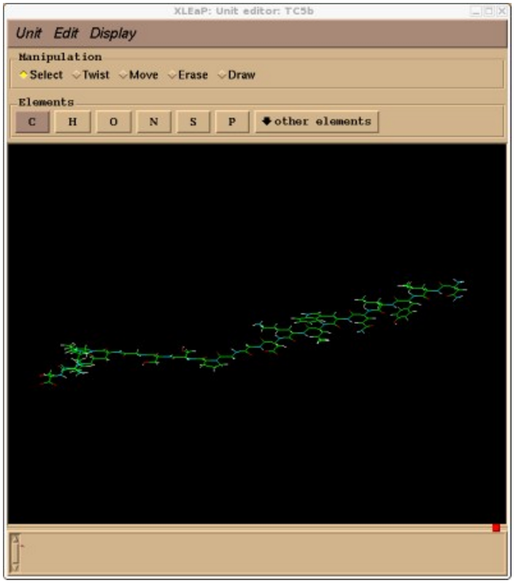
>edit TC5b

Slide 6
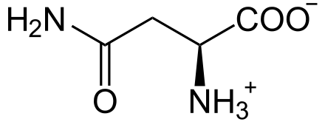
Save this structure as a library file so we can come back to it later
> saveoff TC5b TC5b_linear.lib
We will also save a pdb file of this structure so we can easily visualize it
>savepdb TC5b TC5b_linear.pdb
X Y Z
occupancy
temperature
factor
ATOM 1 N ASN 1 3.326 1.548 -0.000 1.00 0.00
ATOM 2 H1 ASN 1 4.046 0.840 -0.000 1.00 0.00
ATOM 3 H2 ASN 1 2.823 1.500 -0.875 1.00 0.00
ATOM 4 H3 ASN 1 2.823 1.500 0.875 1.00 0.00
ATOM 5 CA ASN 1 3.970 2.846 -0.000 1.00 0.00
ATOM 6 HA ASN 1 3.672 3.400 -0.890 1.00 0.00
ATOM 7 CB ASN 1 3.577 3.654 1.232 1.00 0.00
ATOM 8 2HB ASN 1 2.497 3.801 1.241 1.00 0.00
ATOM 9 3HB ASN 1 3.877 3.116 2.131 1.00 0.00
ATOM 10 CG ASN 1 4.254 5.017 1.232 1.00 0.00
ATOM 11 OD1 ASN 1 5.005 5.340 0.315 1.00 0.00
ATOM 12 ND2 ASN 1 3.985 5.818 2.266 1.00 0.00
ATOM 13 1HD2 ASN 1 4.408 6.734 2.315 1.00 0.00
ATOM 14 2HD2 ASN 1 3.360 5.504 2.994 1.00 0.00
ATOM 15 C ASN 1 5.486 2.705 -0.000 1.00 0.00
ATOM 16 O ASN 1 6.009 1.593 -0.000 1.00 0.00
ATOM 17 N LEU 2 6.191 3.839 -0.000 1.00 0.00
ATOM 18 H LEU 2 5.715 4.730 -0.000 1.00 0.00
ATOM 19 CA LEU 2 7.640 3.839 -0.000 1.00 0.00
ATOM 20 HA LEU 2 8.004 3.325 0.890 1.00 0.00
ATOM 21 CB LEU 2 8.189 3.127 -1.232 1.00 0.00
ATOM 22 2HB LEU 2 7.841 2.094 -1.241 1.00 0.00
asparagine

Slide 7
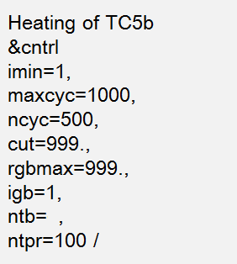
2: Creating the prmtop and inpcrd files.
> saveamberparm TC5b TC5b.prmtop TC5b.inpcrd
3: Minimizing, Heating, Production
$AMBERHOME/bin/sander -O -i heat.in -o heat.out -p TC5b.prmtop -c TC5b.inpcrd -r heat.rst
heat.in
What does the command do?
imin=1 means minimization!
imin=0 means not minimization!
This is actually minimization!

Slide 8
3: Minimizing
$AMBERHOME/bin/sander -O -i min.in -o min.out -p TC5b.prmtop -c TC5b.inpcrd -r min.rst
min.in
ntb = 1: periodic box condition (PBC)
ntb = 0: no PBC
Minimizing of TC5b
&cntrl
imin=1,
maxcyc=1000,
ncyc=500,
cut=999.,
rgbmax=999.,
igb=1,
ntb=0,
ntpr=100 /
What should be the value of ntb?
We have not solvated the peptide into water!
So there are no water molecules in the system!
Because no water, it is unnecessary to use PBC.
cut = 999 too large, actually no cut-off at all
Because of no water, the system is small,
full computation is not a problem,
no need of cut off.
Indeed, it takes about 3.5 seconds on 16 cpus of a 1.3GHz SGI Altix.

Slide 9
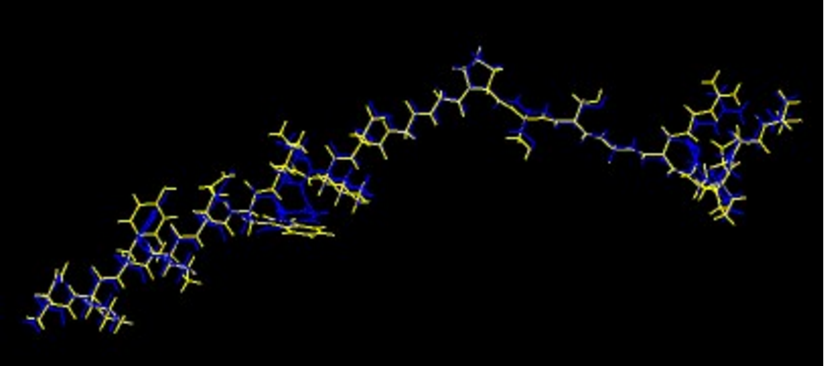
We want to see the structure after the minimization, which file should we examine?
$AMBERHOME/bin/sander -O -i min.in -o min.out -p TC5b.prmtop -c TC5b.inpcrd -r min.rst
But it cannot be viewed directly, a conversion should be perfromed
$AMBERHOME/bin/ambpdb -p TC5b.prmtop < min.rst > min.pdb
Min.pdb
TC5b_linear.pdb

Slide 10
Heating
0 K
325 K
Let the temperature T gradually increase from to .
Initial crystal structure is static, which corresponds to 0K
Many target temperatures
0 50 K 100K 150 K … 325 K

Slide 11
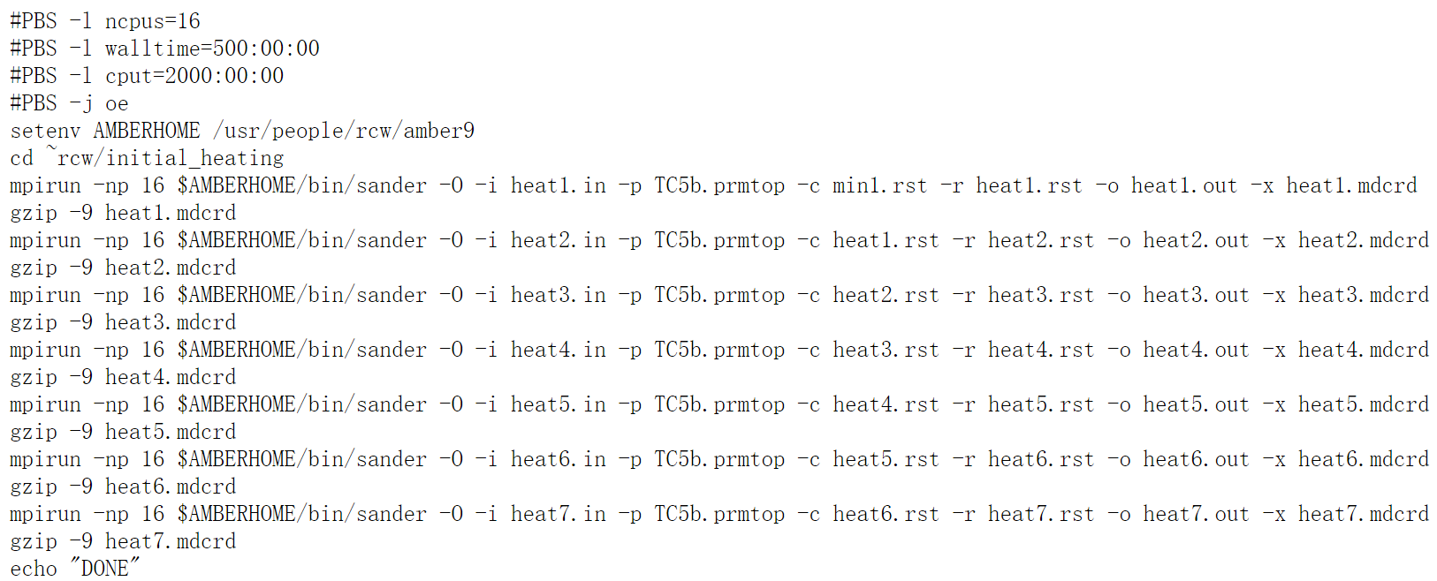
4: Heating the system up.
A Portable Batch System (PBS) script
Notes:
<number>

Slide 12
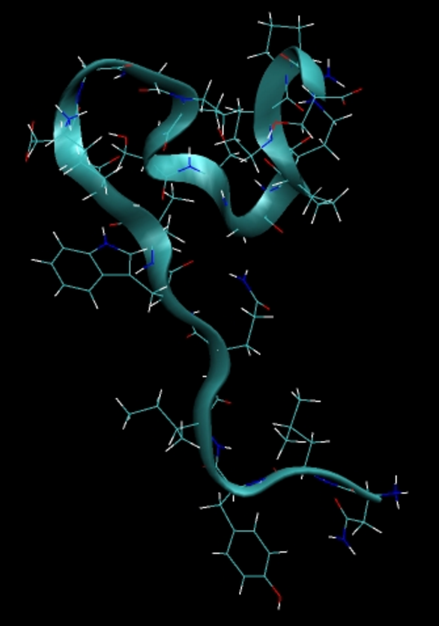

Slide 13
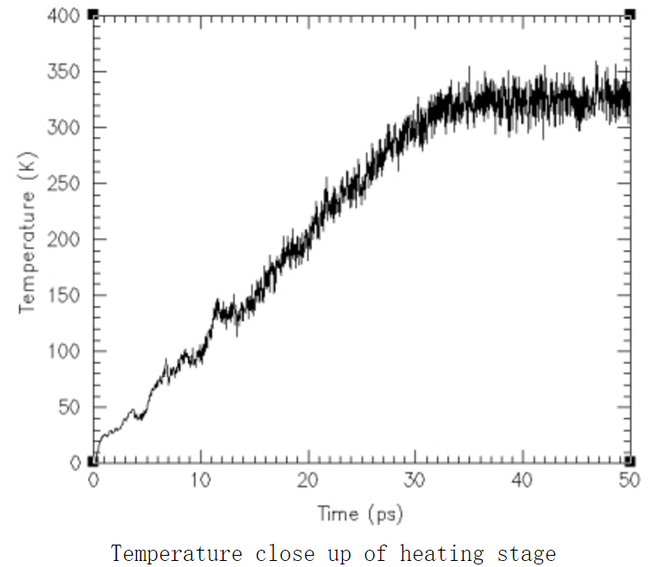

Slide 14
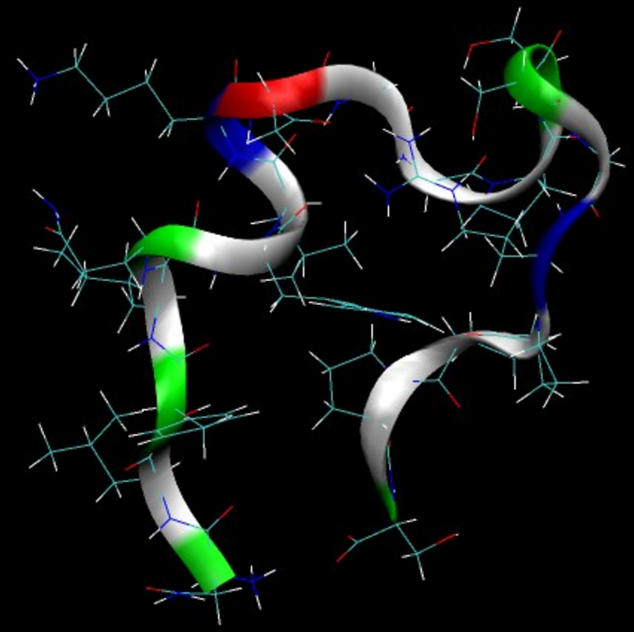
5: Production MD
Simulating 50 ns protein folding process
It takes a total of about 27 hours to run on 16 cpus of a 1.3GHz SGI Altix.

Slide 15
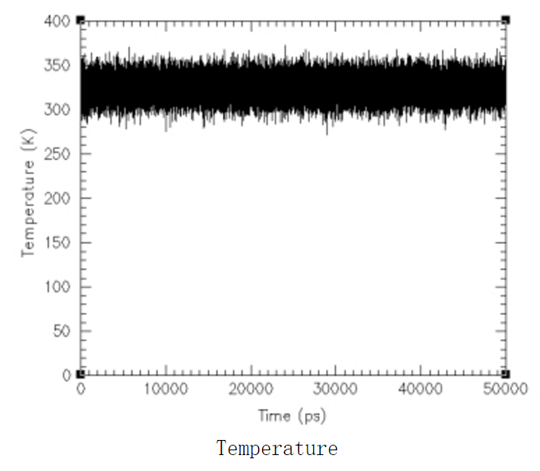

Slide 16
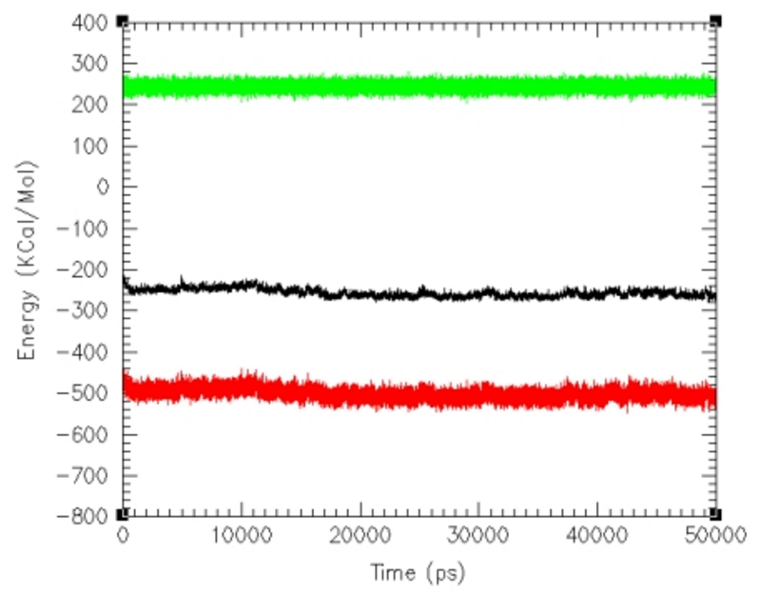
Kinetic energy
Total energy
Potential energy
Note the reduction of total energy and potential energy at about 12000 ps. The meaning?
The structure switches to a more stable one at about 12000 ps.

Slide 17
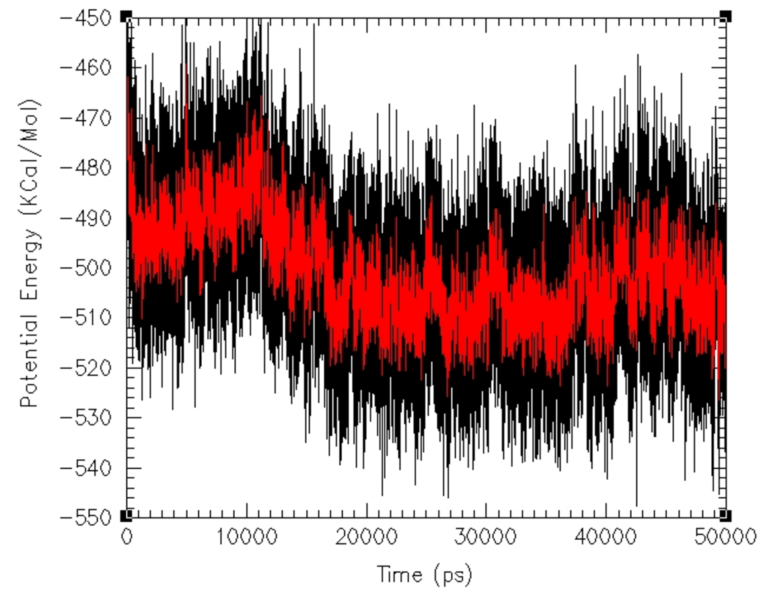
A closer view of potential energy only
Black = original
Red = running average over 10ps
What is the lowest potential energy? At about which time point?

Slide 18
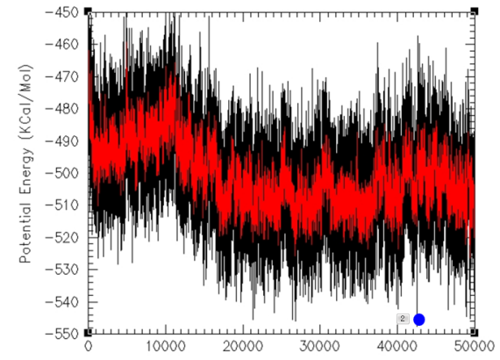
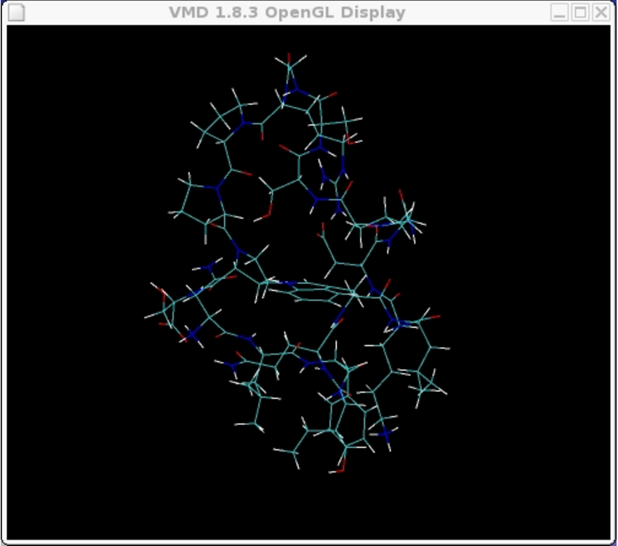
We are interested in the corresponding structure

Slide 19
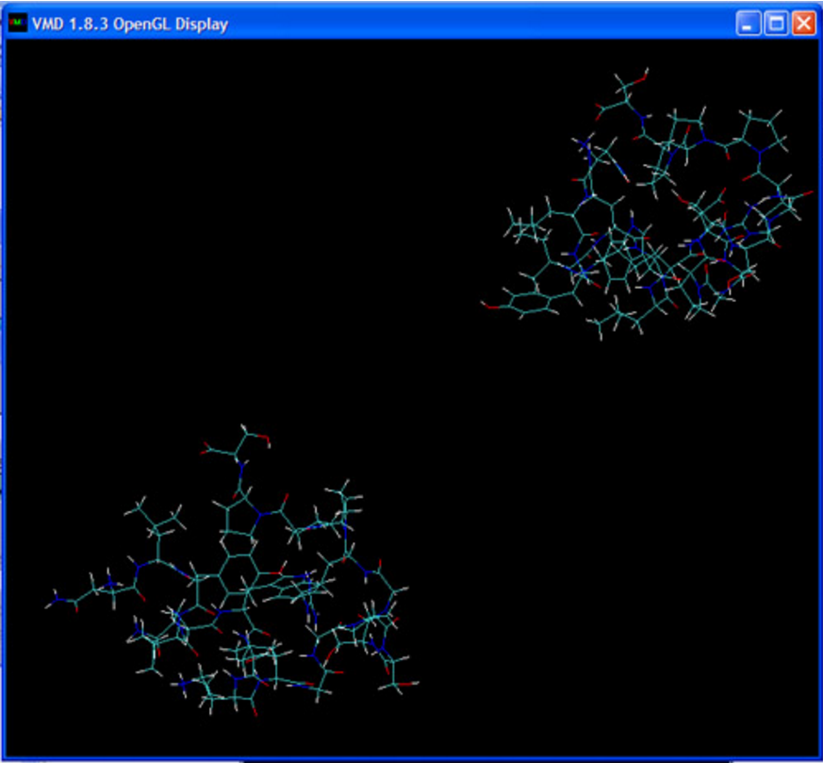
The simulation had been done before the real NMR structure (1L2Y.pdb) was discovered.
We now eager to see whether the simulated structure is close to the real structure
We load the structures into VMD environment

Slide 20
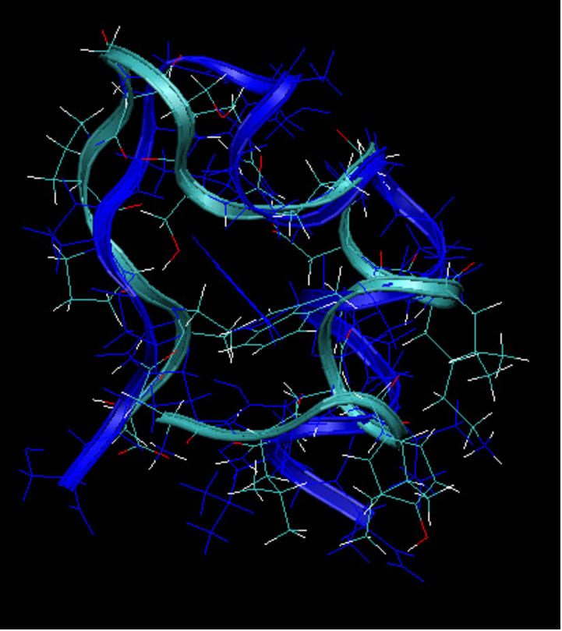
Alignment: making the two structures as close as possible (minimize RMSD)
RMSD = 3.72
Not a good fit
The 50ns simulation
may be not long enough
But we want to know if
The major structure,
alpha-helix, is folded well

Slide 21
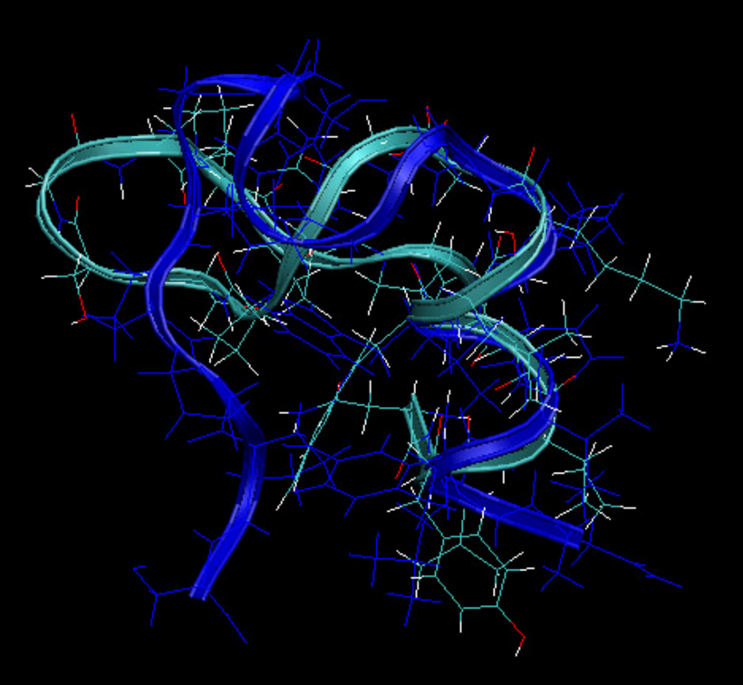
Partial alignment: just align the alpha-helix (residues 3 to 9)
RMSD = 0.7
good fit
So the simulation is meaningful

Slide 22
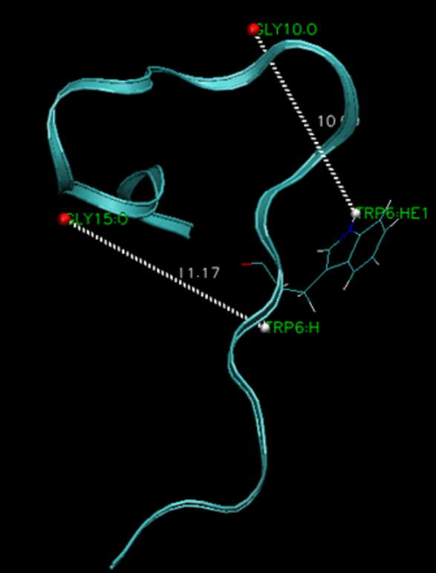
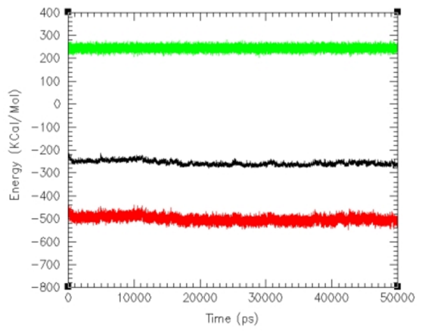
Finally, it can be explained why a sudden energy reduction
i.e., from one stable structure to another one.
It is found that during the first 15ns, two hydrogen bonds formed that
Keeps the structure trapped at a higher minimal energy, preventing formation of alpha-helix

Slide 23
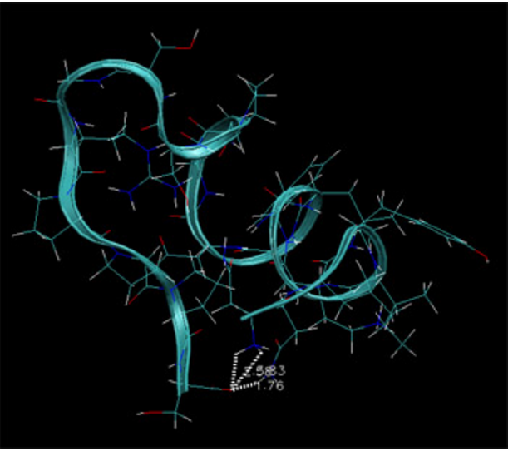
The hydrogen bonds break at 15ns or so, which allows the formation of alpha-helix
Notes:
<number>

Slide 24
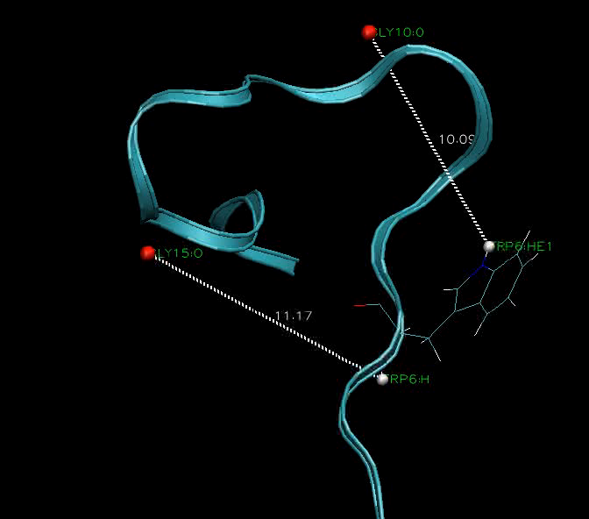

Slide 25
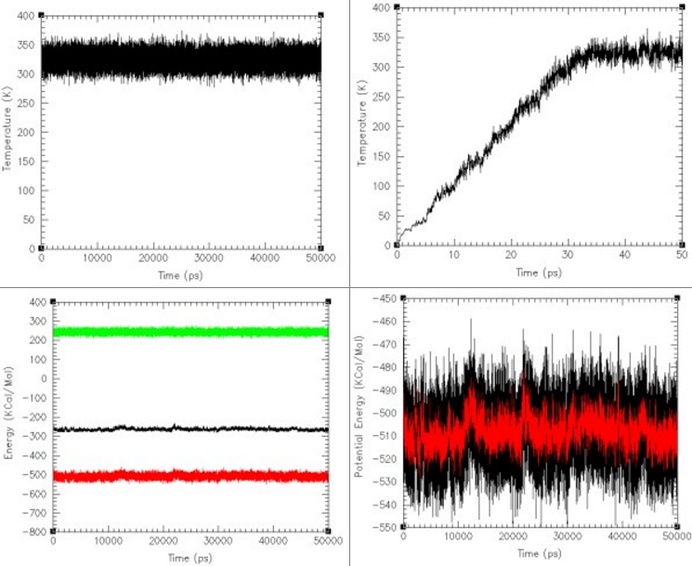
Starting from the NMR structure

Slide 26
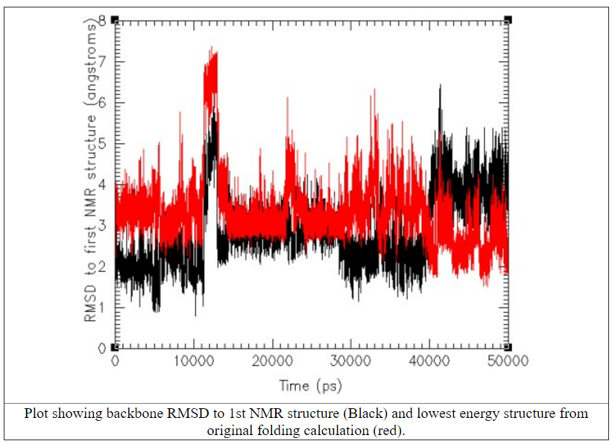
RMSD

